Slide 1



Advance Database Management System
PRESENTATION

Slide 2





PRESENTATION TITLE
Pizza Ordering and Management System using PHP & MySQL

Slide 3






Group Members
Aimen Hussain
Sumaira Yasmeen
Sania Arshad
2023-Bcs-098
Eman Waheed
2023-Bcs-027
2023- Bcs-002
2023- Bcs-086

Slide 4






ALRIGHT
LET’S DIVE IN

Slide 5

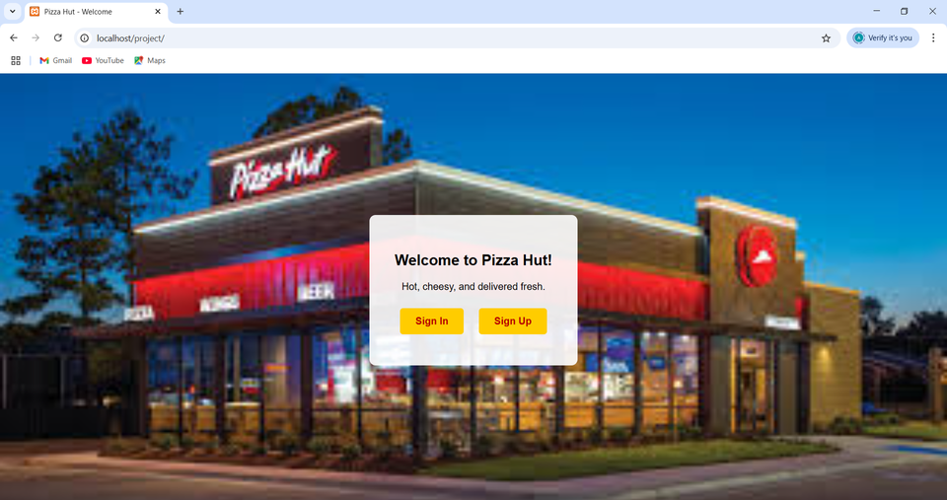
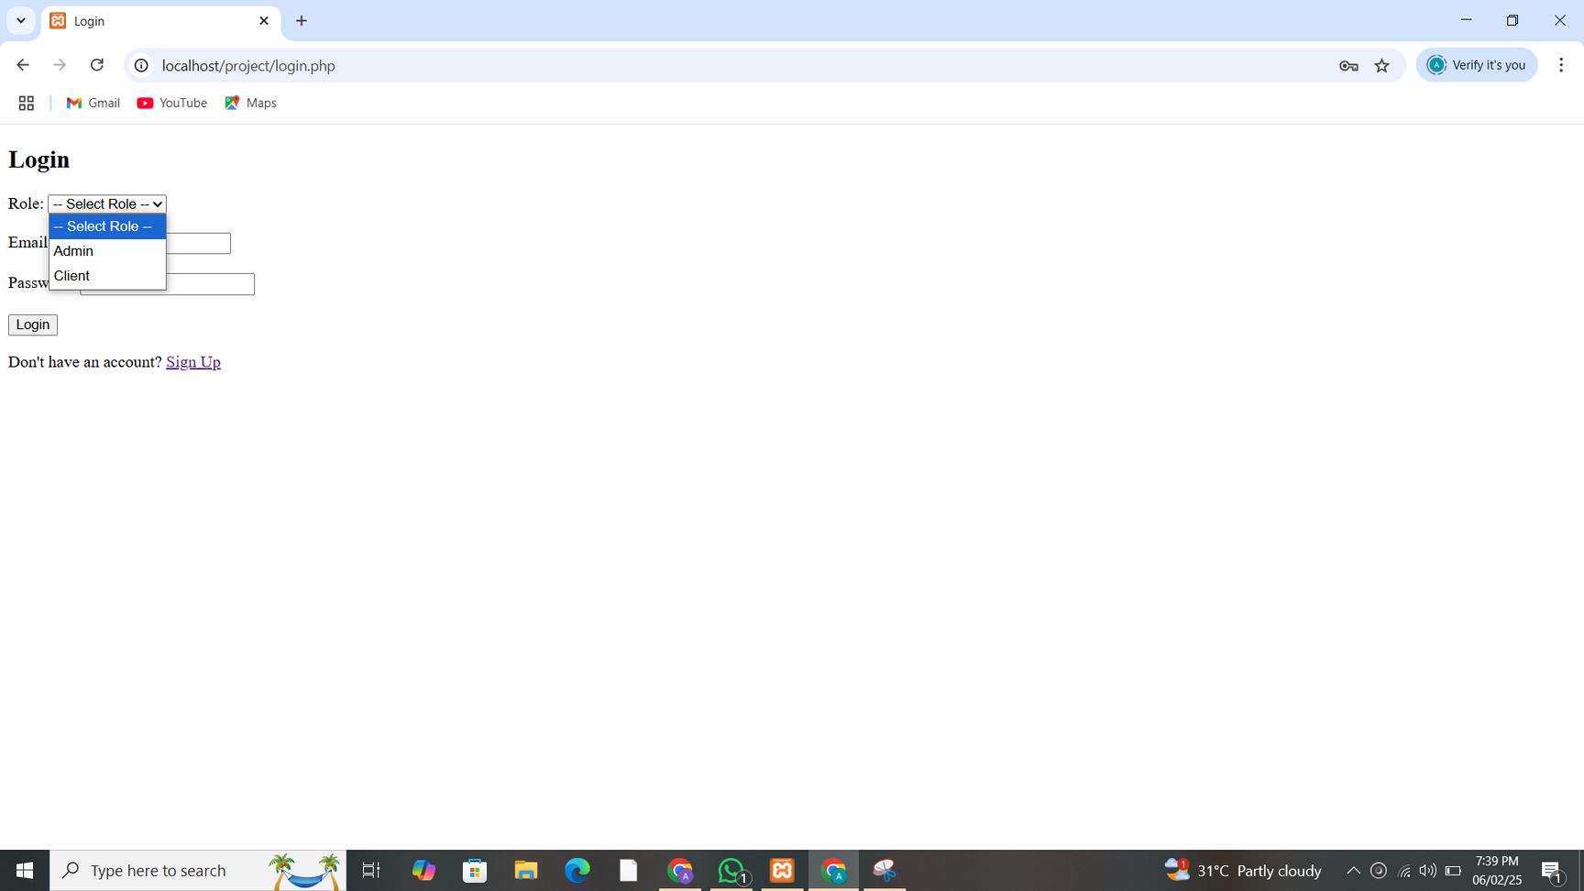

Project Overview
What is the system?
An online platform for ordering pizzas, managing customer orders, feedback, and payments.
Introduction:
This project is a web-based Pizza Ordering and Management System developed using PHP and MySQL. It is designed to streamline the process of ordering pizzas online while providing administrative control over menu management, orders, payments, and customer feedback.
The system supports two types of users:
Client/User: Can register, log in, view the pizza menu, place orders, make payments, and submit feedback.
Admin: Has access to a dashboard to manage pizzas, track orders, view payments, and respond to user feedback.

Slide 6

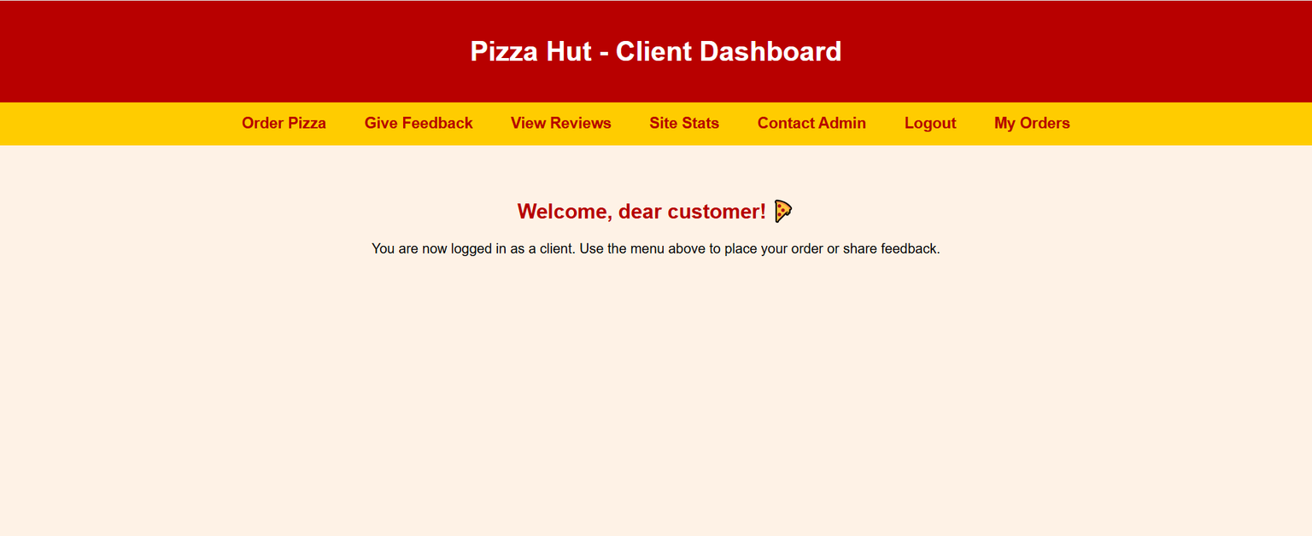
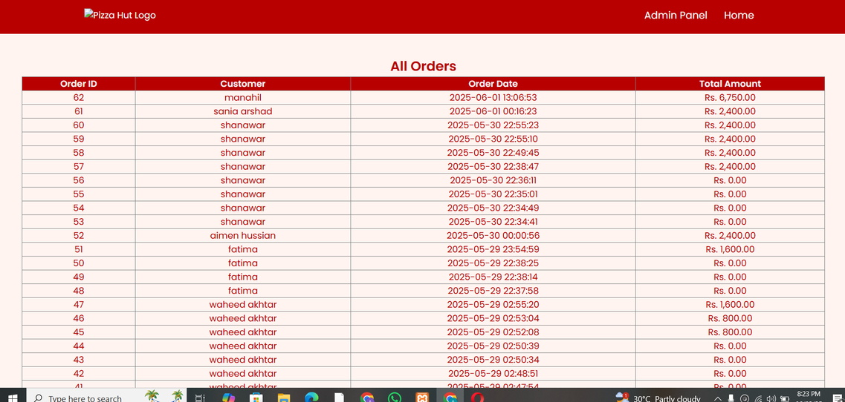
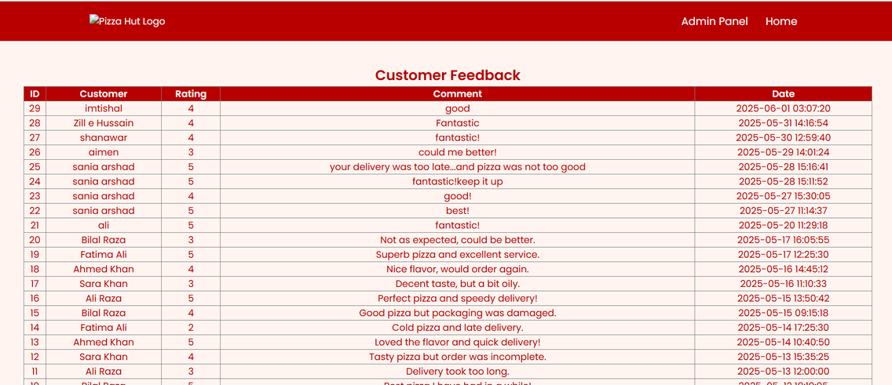

Key Features:
Online pizza menu
User login (Admin & Client)
Cart and order placement
Payment integration
Feedback system

Slide 7
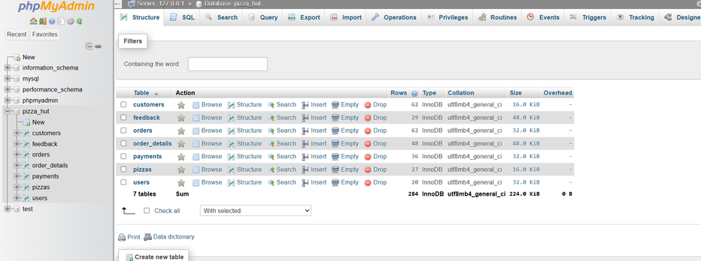
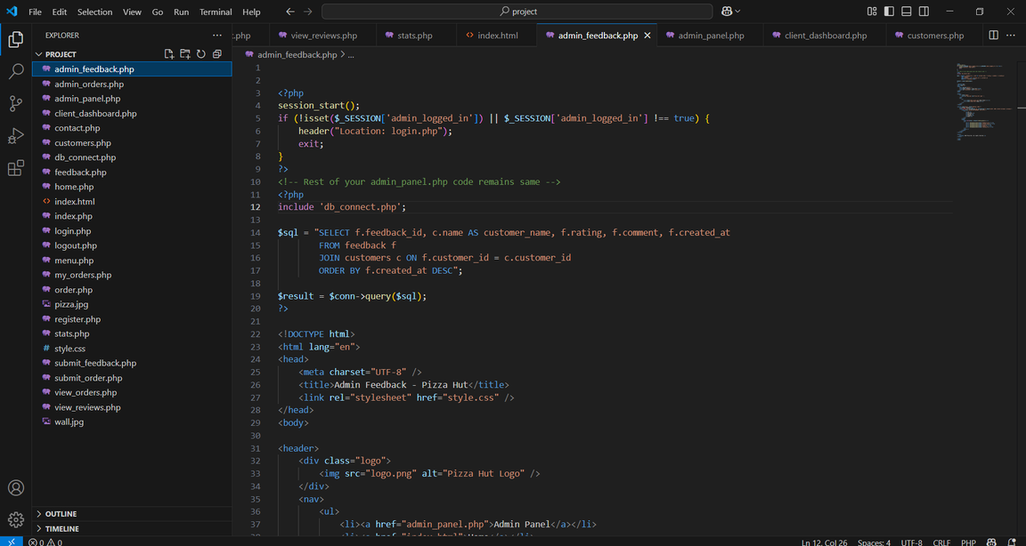
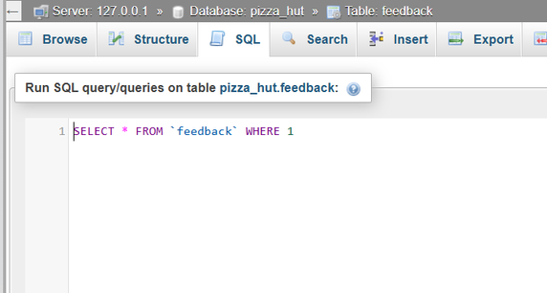
Tools and Technologies Used
Frontend: HTML, CSS
Backend: PHP
Database: MySQL
Server: XAMPP (Apache + MySQL)
IDE: Visual Studio Code
Why we chose them:
Easy setup with XAMPP
PHP is widely used for web development
MySQL is efficient for relational data
VS Code offers rich developer tools and extensions

Slide 8
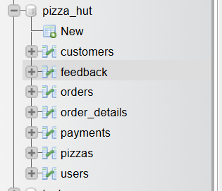
Database Design
Main Tables:
customers
orders
pizzas
feedback
payments
Users
order_details

Slide 9

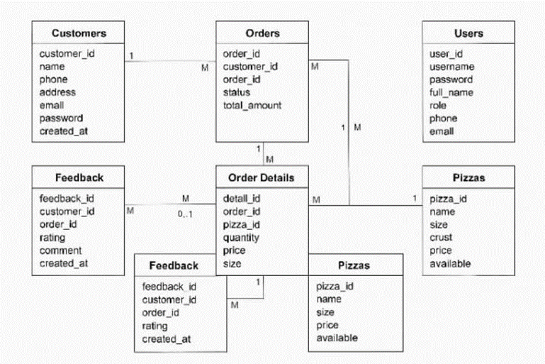

ERD / Schema:
(Insert ER Diagram or list of fields per table)

Slide 10
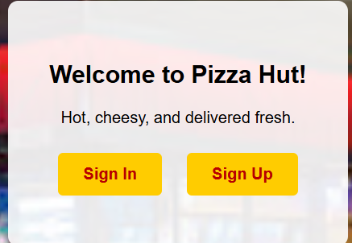
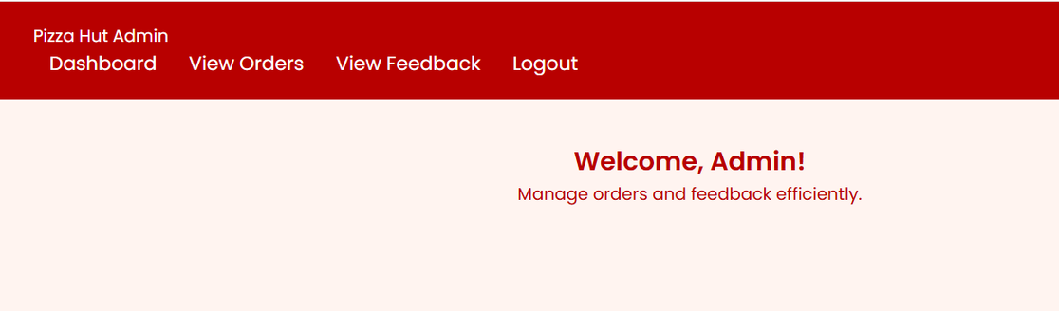
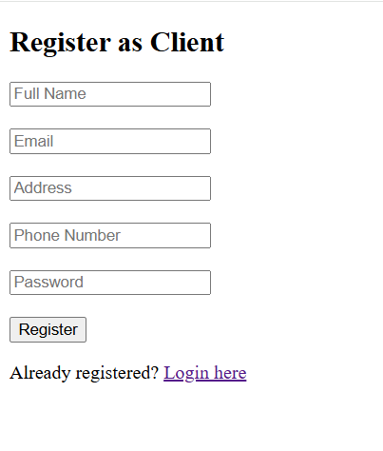
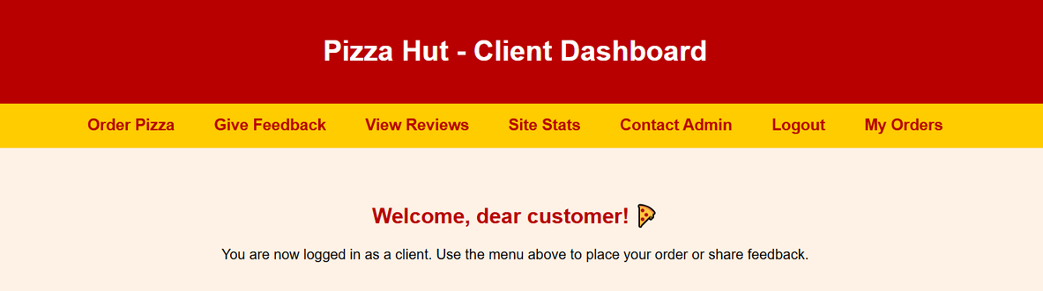
User Registration & Login
Sign-Up Process: Clients register with name, email, password
Login:
Admin: Full control panel access
Client: Can browse, order, give feedback
Security: Sessions used to protect pages and track login status

Slide 11




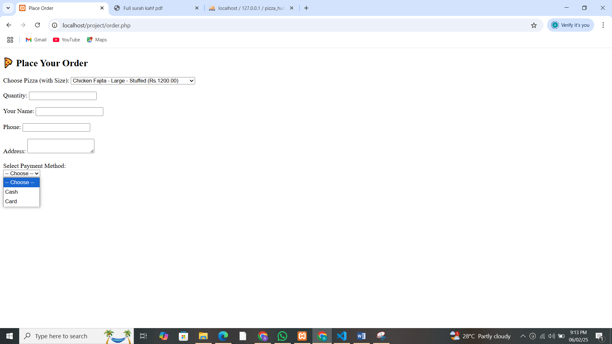
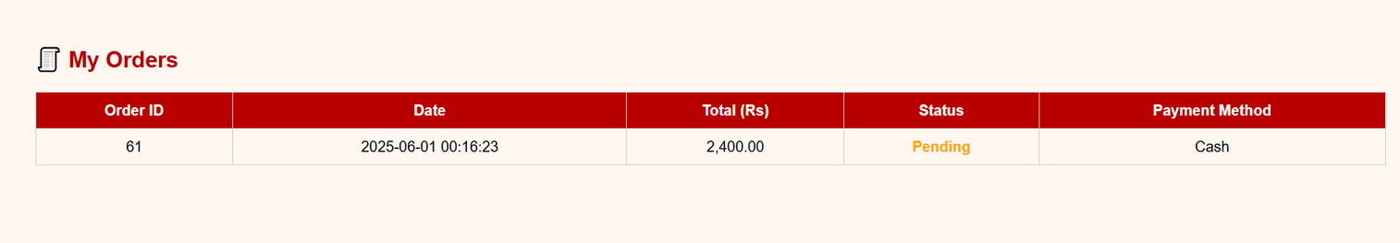


Order & Payment Module
Clients select pizzas and add to cart
Place order with address and payment choice
Order Status: Pending → Delivered
Payment Options:
Cash on Delivery
Credit/Debit Card (simulated)

Slide 12



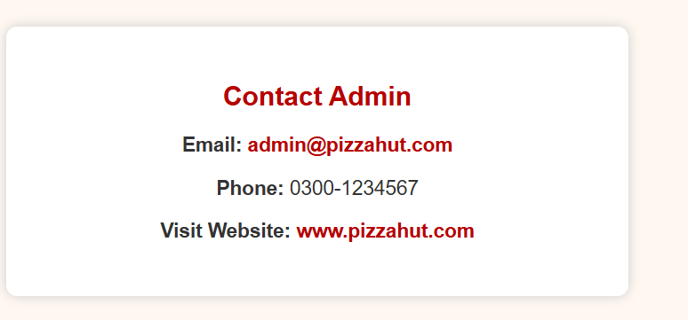
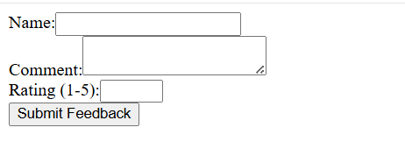

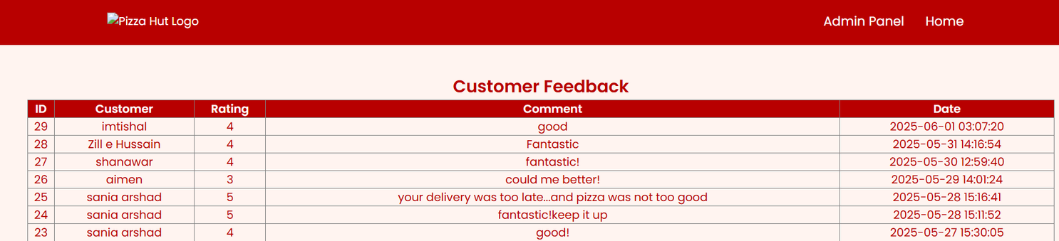
Feedback & Contact Features
Feedback Form: Available on client dashboard
Contact Page: Users send inquiries or comments
Admin Panel: Admins view and manage all feedback and contact requests

Slide 13
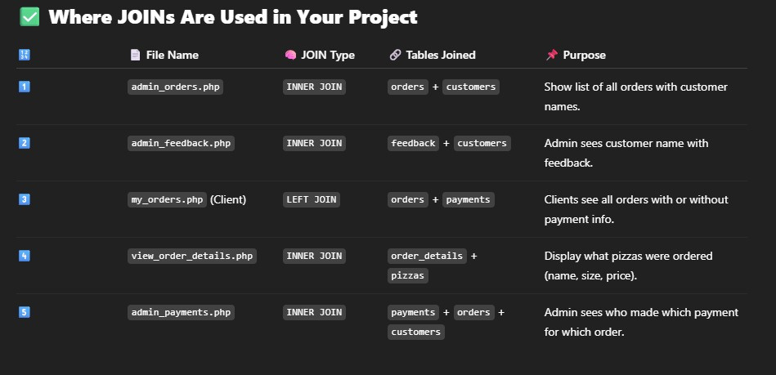
JOIN Queries & SQL Integration
5 JOIN Query Examples:
orders + customers → See who placed which order
payments + orders + customers → Payment tracking
feedback + customers → Match feedback with users
orders + pizzas → Get order item details
orders + payments → Check payment for each order

Slide 14




Security & Validation Techniques
Form Validation: Email format, required fields
Password Hashing: Using password_hash() and password_verify()
SQL Injection Prevention: Prepared statements used in all database queries

Slide 15



Conclusion & Learnings
What we achieved:
Built a complete pizza ordering system
Integrated admin and client roles
Implemented secure login and payment system
Challenges Faced:
Managing session timeouts
JOIN query complexity
Validation and error handling
What we learned:
Full-stack development in PHP & MySQL
Practical experience in ER modeling
Real-world application security basics

Slide 16




SEMESTER-4{2023-2027}

